Slide 1
Air quality monitoring dashboard
Progress Presentation
202355672
Myat Thu Khaing

Slide 2
Contents
Project Overview
Work Done So Far
Responsive Design
Implementing Color Coding for Air Quality Levels
Work in Progress
Source Code and GitHub link
Technologies and Libraries Used
Conclusion

Slide 3
Project overview
Objectives and Website Features

Slide 4
Project Overview
Objective:
Create a responsive web application to monitor and display real-time air quality data, including temperature, humidity, PM2.5, PM10, NO2, NH3, CO2 and SO2 levels.
Use data from OpenWeatherMap and WAQI APIs to display air quality information, weather data, and trends.
Website Features:
Real-time AQI data.
Historical and forecast AQI data.
Weather and air quality comparisons across different locations.
Analysis of air quality trends and relationships with weather parameters.

Slide 5

Work done so far

Slide 6
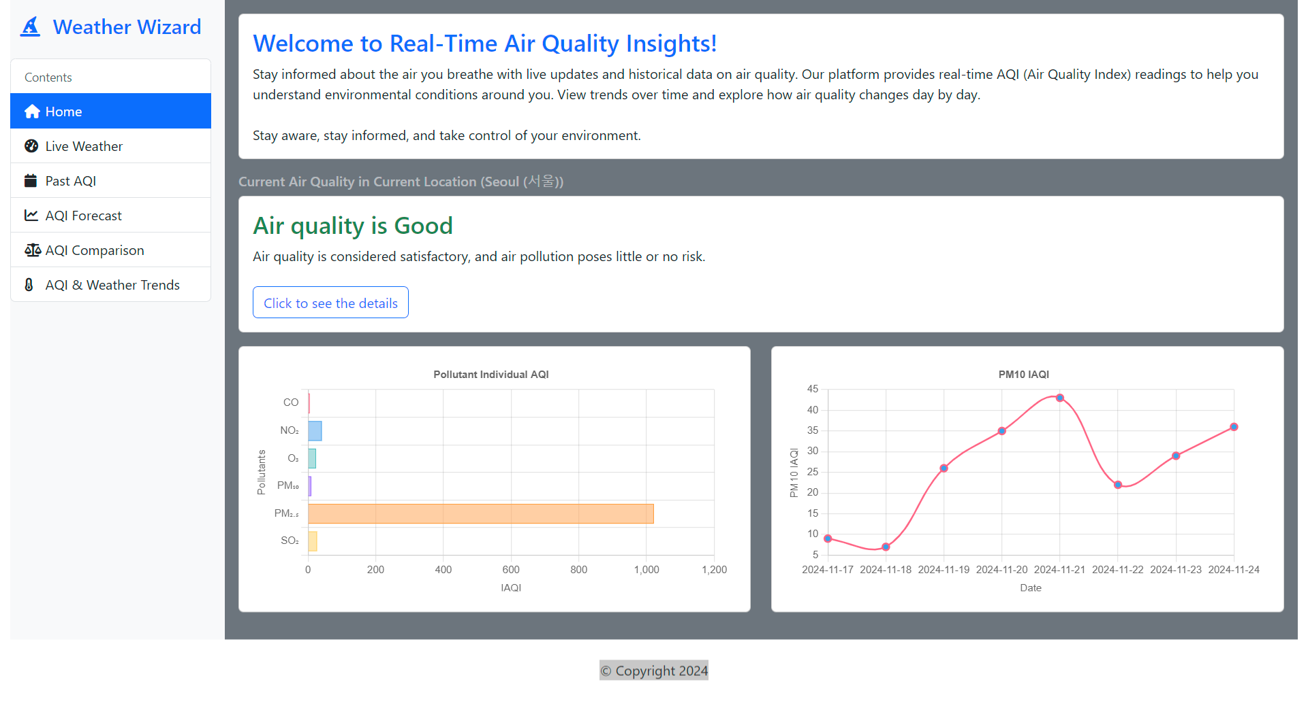
Work Finished (2 Tabs Completed)
Total Tabs: 6 tabs
Home Tab (Completed)
2. Live Weather Tab (Completed)

Slide 7
Home Tab
Displays a welcome message and current air quality for the user's location(based on the IP address information).
Includes IAQI bar chart for different pollutants (PM2.5, PM10, NO2, etc.).
PM10 IAQI Forecast Chart for future air quality predictions.
Responsive design: The layout adjusts to different screen sizes (desktop, mobile).

Slide 8
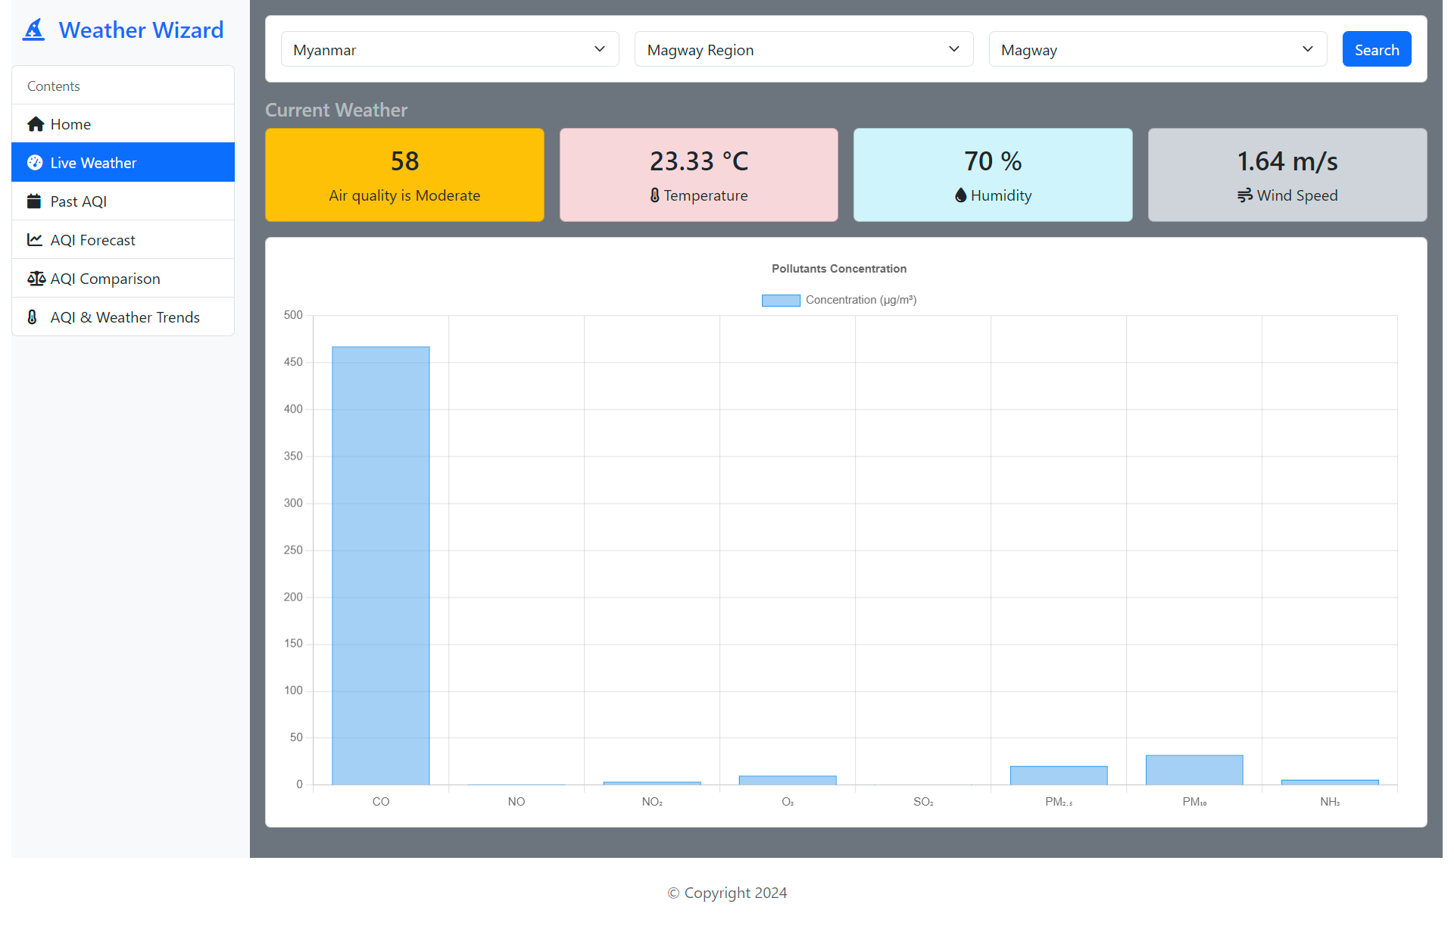
Live Weather Tab
Allows users to select country, state, and city.
Displays real-time weather information (temperature, wind speed, humidity).
Pollutants concentration chart for detailed AQI data of selected city.
Responsive design: Content is adjusted to fit different screen sizes while keeping the layout user-friendly.

Slide 9
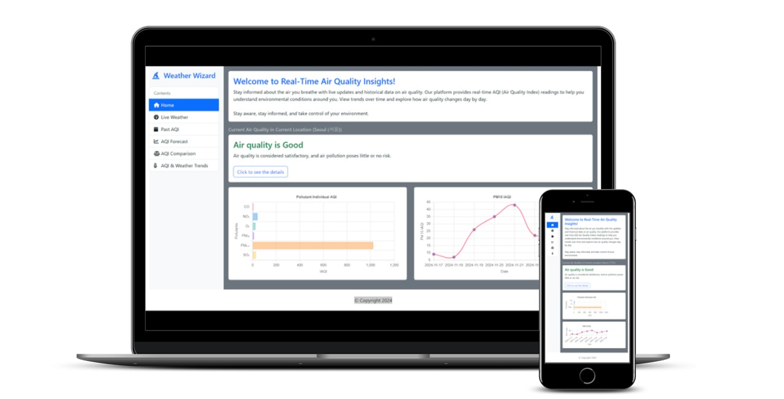
Responsive Design
Home Tab:
The layout adjusts for mobile devices, where the IAQI bar chart and PM10 forecast are stacked vertically to fit smaller screens.
Navigation bar and other UI elements like buttons adapt for better usability on smaller devices.

Slide 10
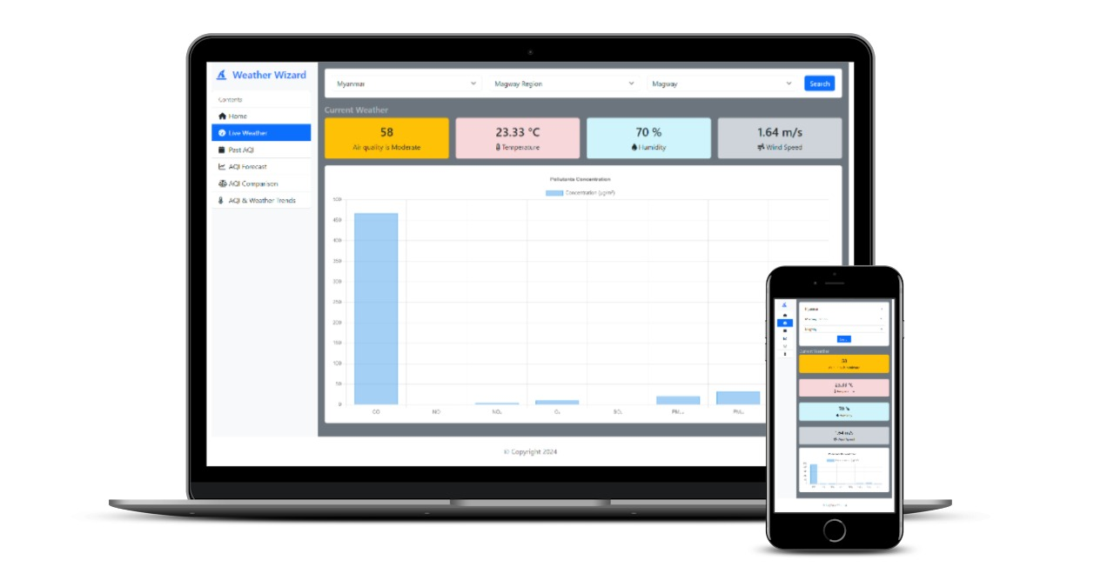
Responsive Design
Live Weather Tab:
Location search section and weather details adjust to fit screens from mobile to desktop without breaking the layout.
Charts and graphs resize and remain legible on any screen size.

Slide 11
Work in Progress
Past AQI Tab:
Will show historical AQI data for a selected location.
Displays AQI values over time (maybe daily, weekly, monthly).
AQI Forecast Tab:
Will provide future AQI predictions based on weather and pollution models.
AQI Comparison Tab:
Users will be able to compare AQI data between two cities.
This will help users understand the air quality differences geographically.
AQI & Weather Trend Tab:
A key feature for analyzing correlations between AQI and weather parameters like temperature and humidity.
Displays graphs showing how AQI levels vary with changing weather conditions.

Slide 12
Implementing Color Coding for Air Quality Levels
AQI Color Coding
Good (0-50): Green
Moderate (51-100): Yellow
Unhealthy for Sensitive Groups (101-150): Orange
Unhealthy (151-200): Red
Very Unhealthy (201-300): Purple
Hazardous (301-500): Darkred
Color coding provides visual clarity and makes it easier for users to quickly understand air quality levels.
The color scale corresponds to different AQI categories, allowing users to see the air quality at a glance without needing to read detailed data.

Slide 13

Source code and GitHub link
Source code: https://github.com/Myatthu17/AQI-website-project
GitHub live demo Page: https://myatthu17.github.io/AQI-website-project/

Slide 14
Technologies and Libraries Used
HTML/CSS/JavaScript: For website structure, styling, and interactivity.
Chart.js: Used to create dynamic charts for AQI data visualization and trend analysis.
OpenWeatherMap and WAQI APIs: APIs that provide real-time and historical air quality and weather data.
CountryStateCity API: API that provide all Countries, States, Cities with ISO2, ISO3, Country Code, Phone Code, Capital, Native Language, Time zones, Latitude, Longitude, Region, Subregion, Flag Emoji, and Currency.
jQuery: A JavaScript library for simplifying DOM manipulation and event handling.
Bootstrap: A front-end framework for responsive web design and components.
FontAwesome: A library for scalable vector icons used for enhanced UI elements.

Slide 15
THANK YOU
Myat Thu Khaing
202355672

